Slide 1
Western Countries Financial Data Analysis
Capstone Project
Presented by Niranjan (Business Analyst)

Slide 2
INTRODUCTION
In this project, we delve into the financial data of Western countries to derive insights and recommendations for strategic business decisions.
We follow six key steps: Ask, Prepare, Process, Analyze, Share, and Act. Let's dive in!

Slide 3
Step 01: - Ask
Business Objectives:
Optimize Profits: We aim to determine how we can best optimize our profits.
Identify Emerging Trends: We seek to identify emerging market trends that can give us a competitive edge.
Recommendations: We will use these insights to formulate actionable recommendations for our organization
Deliverables:
A clear, concise summary of our business objectives. A clear, concise summary of our business objectives.
Comprehensive documentation of all data cleaning, manipulation, and analysis.
Formulation of recommendations based on our analysis, designed to guide strategic decision-making.

Slide 4
Step 02: - Prepare
Dataset Overview: The dataset comprises 701 rows, with 700 rows dedicated to pure data and one row containing column headers. The recorded data spans two years, starting from the 1st of September 2013 (the first date of transaction) to the 1st of December 2014 (the last shipping date). We've chosen to use this date range to represent two years of business activity. The dataset encompasses information about 5 unique countries, 5 unique segments and 6 unique products.
Data Columns: The dataset consists of 16 columns, each serving as a unique attribute: Segment, Country, Product, Discount Band, Units Sold, Manufacturing Price, Sale Price, Gross Sales, Discounts, Sales, COGS, Profit, Date, Month Number, Month Name, Year.

Slide 5
Step 03: - Process
In the "Process" phase, we will ensure that our dataset is well-prepared and cleaned to facilitate for further analysis. We will utilize Excel for this purpose, as the data is already in XLSX format.
Data Cleaning: I examine the data thoroughly in Excel and reaches to the conclusion. Data is almost clean except some minor error in Data Type. Additionally, we convert the Year column from text format to a numerical format for consistency and clarity in data interpretation.

Slide 6
Step 04: - Analyze
We approach our data analysis through a structured process, leveraging Excel, SQL, and Power BI to extract insights and drive informed decision-making. Our methodology consists of:
Excel Statistical Analysis: Extracting correlation, using statistical tools, and presenting findings visually.
SQL Analysis: Manipulating data with SQL queries for deeper insights.
Power BI Dashboard : Integrating data into Power BI, designing dynamic dashboards for reporting.

Slide 7
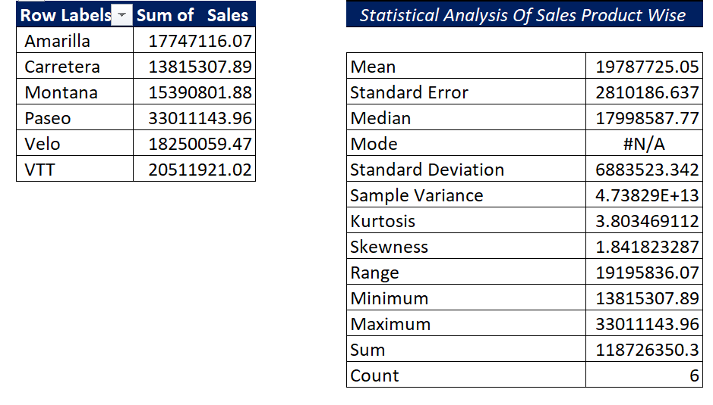
Insights from the Product-wise statistical sales analysis:
Paseo leads with $33011143.96 in sales.
VTT follows closely with $20511921.02.
Carretera Product contributes lowest in Sales is $13815307.89.

Slide 8
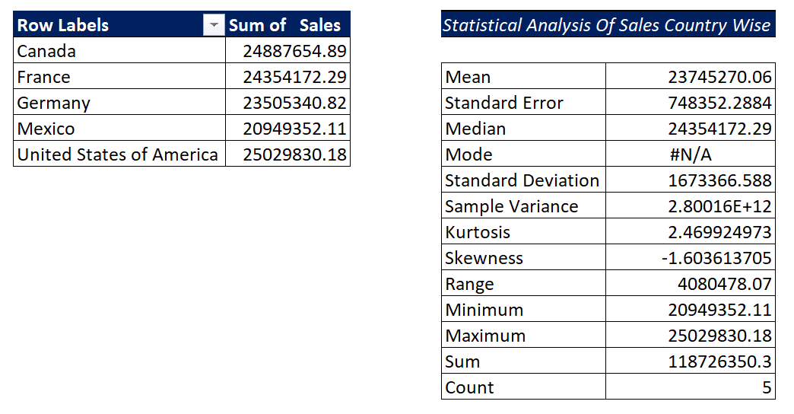
Insights from the country-wise statistical sales analysis:
USA leads with $25,029,830.18, followed closely by Canada and France.
Germany and Mexico also contribute significantly to total sales.
Mean sales amount aligns closely with the United States' sales figure, indicating consistent performance.

Slide 9
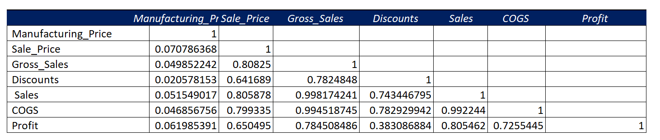
Correlation Analysis of Manufacturing Price, Sale Price, Gross Sales, Discounts, Sales, COGS, Profit is: -
Strong positive correlation between Sale Price and Gross Sales (0.8083), indicating higher prices correlate with higher sales revenue.
Moderate negative correlation between Discounts and Gross Sales (-0.7825), implying discounts may reduce overall revenue.
Strong positive correlation between Sales and Gross Sales (0.9982), suggesting most sales directly contribute to gross sales.
Strong positive correlation between COGS and Gross Sales (0.9945), indicating higher sales are associated with higher production costs.
Moderate positive correlation between Profit and Gross Sales (0.7845), indicating higher sales contribute to improved profitability.

Slide 10
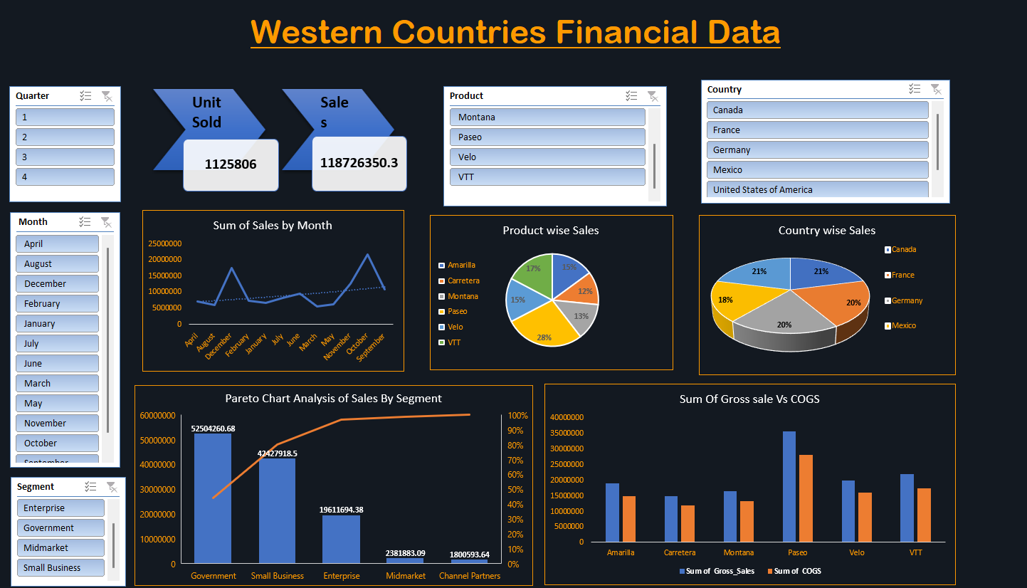
ii. Excel Graphical Analysis:

Slide 11
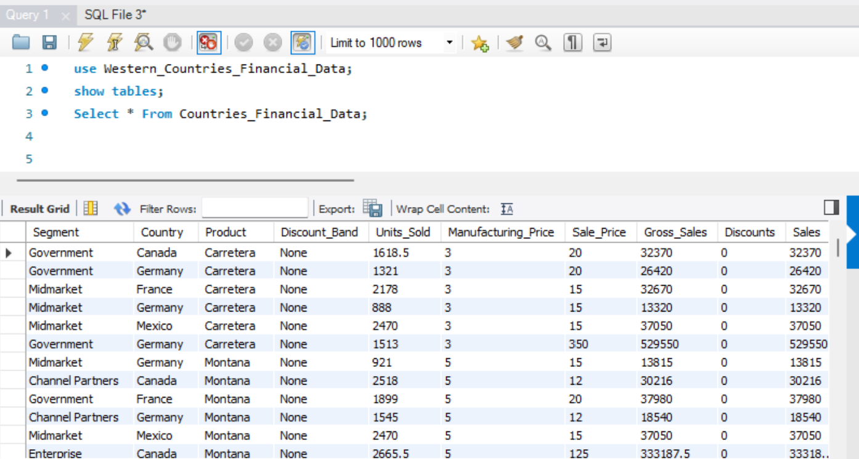
iii. SQL Analysis:
Let’s load our data into SQL and check the first 5 rows to make sure it imported well.
Select Top 5 * From Western_Countries_Financial_Data;
We are using SQL Database for our analysis Through SQL queries, we'll answer critical questions, helping us gain a deeper understanding of the dataset. These insights will be pivotal in addressing the business problem effectively

Slide 12
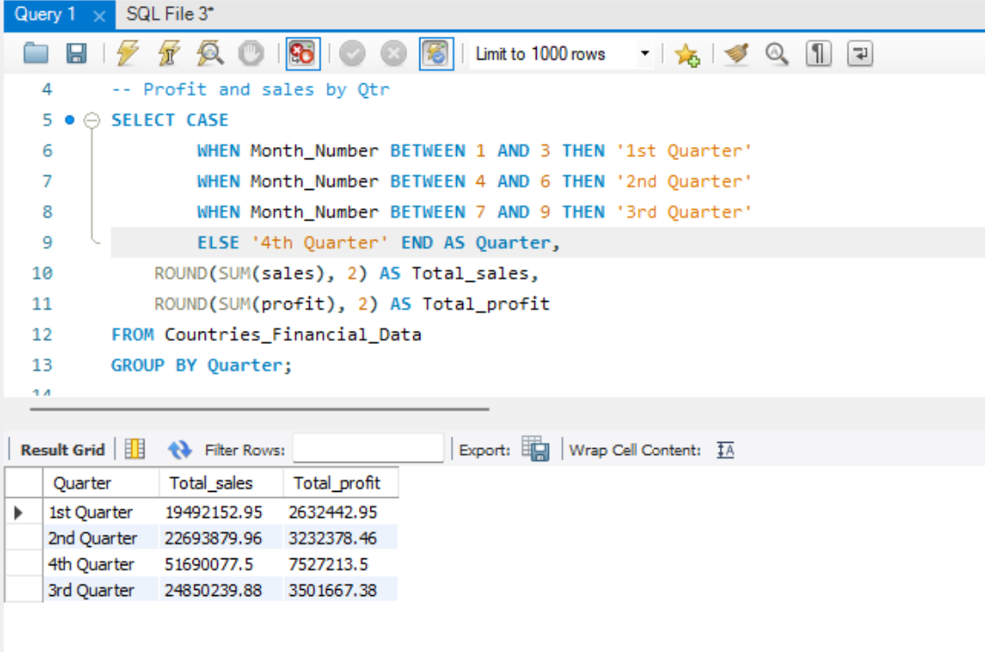
iii. SQL Analysis:
Profit and sales by Qtr
Quarterly sales and profits show a consistent upward trend throughout the year, with Q4 exhibiting the highest sales ($51,690,077.51) and profits ($7,527,213.50), suggesting a strong performance and potential for strategic planning to maintain growth momentum.

Slide 13
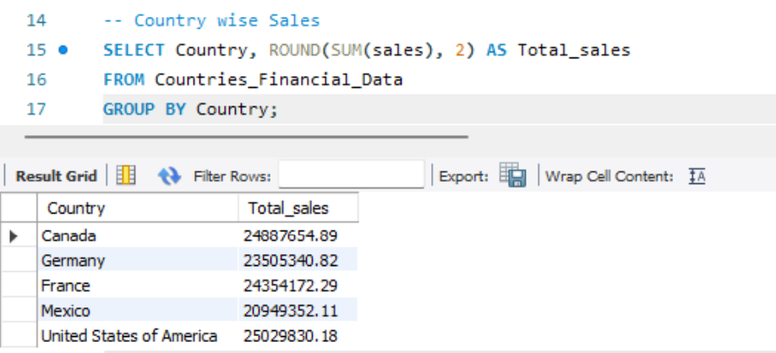
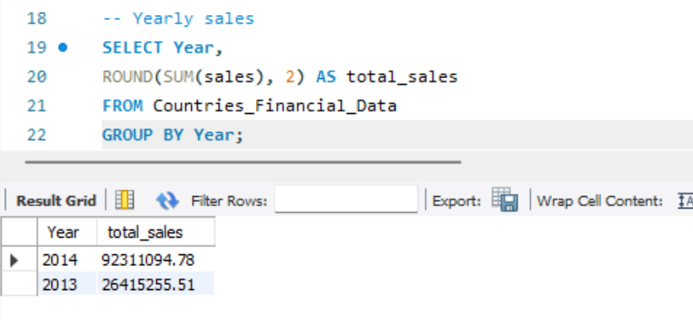
iv. SQL Analysis:
Yearly Sales
Country wise sales
Yearly sales significantly increased from 2013 ($26,415,255.52) to 2014 ($92,311,094.79), indicating a substantial growth trend over the year. Also, increased because in 2013 our operation was only active for 4 months.
The United States of America leads in country-wise sales with $25,029,830.18, followed closely by Canada ($24,887,654.89), France ($24,354,172.30), Germany ($23,505,340.82), and Mexico ($20,949,352.11), showcasing a competitive distribution of sales across these key markets.

Slide 14
To import data from MySQL Workbench to Power BI
Open Power BI Desktop: Launch Power BI Desktop application on your computer.
Get Data: Click on the "Get Data" button located on the Home tab of the Power BI Desktop.
Select MySQL Database: In the "Get Data" window, choose "MySQL database" from the list of available data sources.
Enter Connection Details: Enter the required connection details such as server name, database name, and authentication method.
Connect to MySQL Database: Click on the "Connect" button to establish a connection to your MySQL database.
Select Tables or Write Query: Once connected, you can either select specific tables you want to import or write custom SQL queries to retrieve data.
Load Data: After selecting tables or writing queries, click on the "Load" button to import the data into Power BI.
Data Import Complete: Power BI will import the data from MySQL Workbench into your Power BI Desktop application. You can now use this data to create reports and visualizations.
Data Refresh (Optional): Set up data refresh schedules if you want Power BI to automatically update the imported data at regular intervals

Slide 15
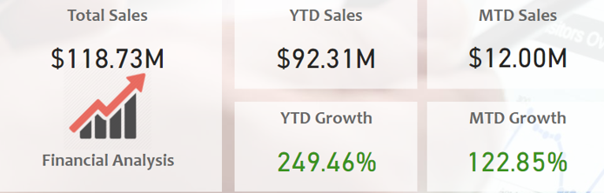
Power BI Summery :
This Analysis dashboard empowers managers and stakeholder to efficiently monitor product sales both by country and Segment, Facilitating targeted strategies for maximizing profitability and diving business growth.

Slide 16
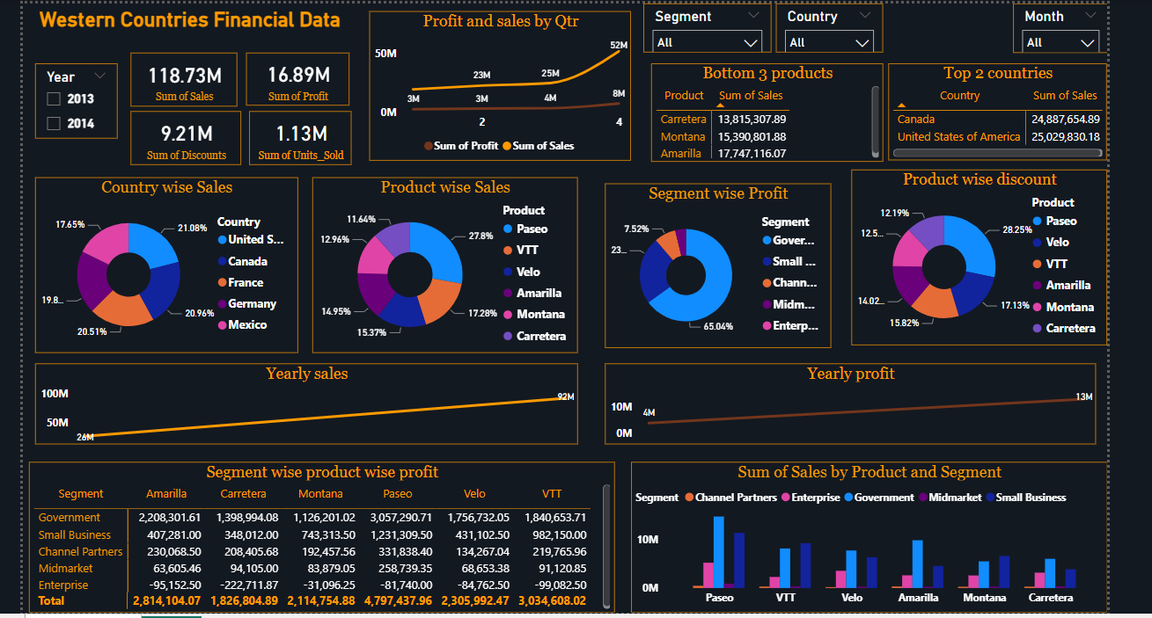
Power BI Dashboard: Power BI Dashboard of Western Countries Financial Data

Slide 17
Analysed
Statistical Analysis in Excel
Explore data distributions, trends, and correlations.
Perform descriptive statistics.
Identify outliers and anomalies.
Visualization Dashboard in Excel
Create visual representations of key metrics.
Design interactive dashboards for data exploration.
SQL Database Import
Establish database schema.
Import data into SQL server.
Verify data integrity through queries.
PowerBI Visualization
Develop interactive visualizations for deeper insights.
Answer key business questions through dynamic dashboards.
Dashboard Slides (Empty)
Product wise Sales
Segment wise Profit
Yearly Sales
Country wise Sales
Profit and Sales by Quarter
Yearly Profit
Top 2 Countries
Bottom 3 Products

Slide 18
Conclusion and Inferences
There is Impressive Growth in Sales in 2014 as compared to 2013 year.
The United States of America has phenomenal record in Terms of Overall Sales.
Paseo has the highest share as compared to other products.
Through, Pareto Chart analysis, Government and Small Business Segment shares almost 80% of sales in 2013 and 2014.
There is trend noticed , sales in December months is highest as Compared to other months.
Through comprehensive data analysis and visualization, we've uncovered valuable insights into the financial landscape of Western countries. Our findings provide actionable recommendations for maximizing profitability and strategic growth opportunities. This project demonstrates the power of business analytics in driving informed decision-making.

Slide 19
Endnotes
Excel Dashboard Link: https://docs.google.com/spreadsheets/d/1LBs1WkvZHW3TcDRcwxLRAqYk4irOTOw2/edit?usp=sharing&ouid=110870154336160920200&rtpof=true&sd=true
Power Bi Dashboard Link: https://drive.google.com/file/d/1ju--k8MGJmHE82DZjUb5QXbhsYZzEAYK/view?usp=sharing

Slide 20


